Slide 1

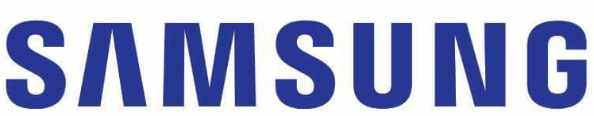

Multi-modal Feature Fusion with Feature Attention for VATEX Captioning Challenge 2020
SRC-B_VC_Lab Team
Ke Lin^{1,2} Zhuoxin Gan¹ Liwei Wang²
¹Samsung Research China –Beijing (SRC-B) ²Peking University
Notes:
Hello, everyone. Thank you for the VATEX Organizers to invite us to give a presentation at the workshop. We are grateful that the challenge Organizers to provide the challenging VATEX dataset to benchmark progress towards models that can describe the videos in various languages such as English and Chinese. Today we are going to introduce our solution for VATEX captioning challenge 2020.

Slide 2
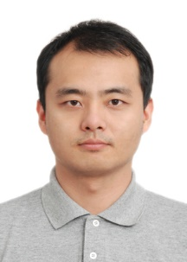


About us
Ke Lin
Zhuoxin Gan
Liwei Wang
Notes:
First, please allow me to introduce our team members. Our team consists of three members from ¹Samsung Research China –Beijing and Peking University. Ke Lin and Zhuoxin Gan are from ¹Samsung Research China –Beijing. Ke Lin and Liwei Wang are from Peking University. I am Ke Lin, today I will introduce our method for this challenge on behalf of our team.

Slide 3
Methods – Data preprocessing
Caption preprocessing
Converting to lower cases
Clip sentences over 30 words
Removing words occurring less than 5 times
Jieba to split Chinese words
Word vocabulary: English 10260, Chinese 12776
Video collection and preprocessing
Crawler from Youtube
~155 video missing
Uniformly sample 32 frames, extract audio
Notes:
The VATEX dataset contains over 41250 video clips in 10 seconds and each video clip depicts a single activity. Each video clip has 10 English descriptions and 10 Chinese descriptions. We use the official 25991 training examples as training data and 3000 validation examples for validation.
For caption preprocessing, we follow the standard caption pre-processing procedure including converting all words to lower cases, tokenizing on white space, clipping sentences over 30 words and filtering words which occur at least five times. We use open source Jieba toolbox to segment the Chinese words. The final vocabulary sizes are 10260 for VATEX English task, 12776 for VATEX Chinese task.
For video data, we use a python crawler to get the video from youtube. About 155 videos are unavailable now. We uniformly sample 32 frames for each video clip. We also extract the audio from the video.

Slide 4
Methods – Feature Extraction
3-D feature pre-trained on Kinetics-600
Official I3D feature
ECO feature (ECCV 2018) https://github.com/zhang-can/ECO-pytorch
SlowFast (ICCV 2019) https://github.com/facebookresearch/SlowFast
2-D feature
PNASNet pre-trained on ImageNet (ECCV 2018), global feature https://github.com/Cadene/pretrained-models.pytorch
Bottom-up feature (CVPR 2018), local feature
Semantic feature
attribute
topic
Audio feature
VGGish https://github.com/tensorflow/models/tree/master/research/audioset/vggish
Notes:
To enlarge the representation ability of the encoder, we extract multi-model feature from motion, appearance, semantic and audio domains.
In order to get motion feature of a given video, we use three types of 3-D CNN networks. First, we use the I3D feature provided by the VATEX challenge organizers. Another 3d network is an ECO network pretrained on Kinetics-400 dataset to extract 2-D and 3-D fusion feature. We also use a 3-D CNN network SlowFast network pretrained on Kinetics-600 dataset, which has the identical data distribution of VATEX.
In order to obtain the appearance feature, we use the PNASNet pretrained on ImageNet on every extracted frame. Inspired by bottom-up attention, local feature is also important for caption generation, so we also extract regional feature using a Faster R-CNN model pretrained on Visual Genome dataset for each extracted frame. Feature from different proposals are averaged to form the bottom-up feature for one frame.
Inspired by some prior work, semantic prior is also helpful for video captioning. We manually select the 300 most frequent words from training and validation set as attributes. The semantic encoder consists of a multi-layer-perceptron on top of the visual features. We also extract topic ground truth from the training and validation set. Attribute and topic detection is treated as a multi-label classification. We concatenate the predicted probability distribution of attributes/topic and the probability distribution of ECO, PNASNet and SlowFast as the semantic feature. Note that semantic feature is a one dimensional vector, we duplicate the semantic feature for N times to align the semantic feature with the dimensions of other visual features, where N is the number of frames.
we also extract audio feature because audio from a video is also a powerful additional information. Our video feature extractor is a VGGish network pretrained on Audioset dataset. We extract MEL-spectrogram patches for each audio. The sample rate of the audio is 16 KHz. The number of Mel filters is 64. The STFT window length is 25 ms and top length is 10 ms.

Slide 5
Methods – Feature Extraction
Ablation study on feature selection
 | CIDEr | BLEU-4 | ROUGE-L | METEOR
ECO | 0.470 | 0.281 | 0.415 | 0.222
ECO+I3D | 0.491 | 0.285 | 0.421 | 0.228
ECO+I3D+PNAS | 0.493 | 0.285 | 0.420 | 0.228
ECO+I3D+PNAS +SF | 0.548 | 0.311 | 0.435 | 0.239
ECO+I3D+PNAS +SF+Semantic | 0.559 | 0.316 | 0.440 | 0.242
ECO+I3D+PNAS +SF+Semantic +BU | 0.560 | 0.313 | 0.436 | 0.242
ECO+I3D+PNAS +SF+Semantic +BU+audio | 0.565 | 0.325 | 0.444 | 0.245
Notes:
We conduct a simple ablation study on feature selection. We gradually increase the types of features, from only ECO feature to all features. Features of different types are averaged to feed to a top-down decoder. The result show that all features are helpful for the CIDEr metric. Among all features, slowfast feature, semantic feature and audio feature are the most helpful features.

Slide 6
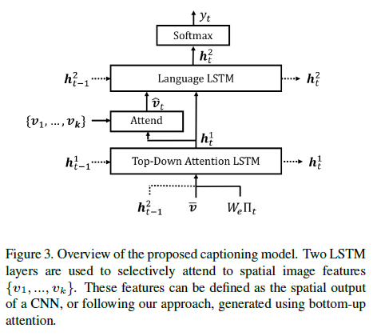
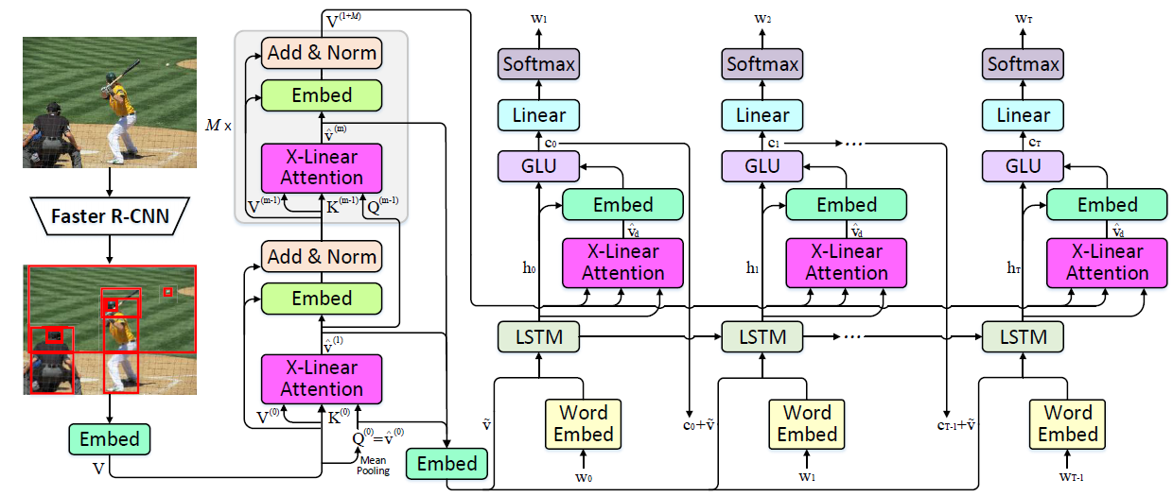
Methods – Model
Top-down (CVPR 2018)
X-LAN (CVPR 2020)
Notes:
We apply two types of decoders in this work, top-down model and X-LAN model. Top-down consists of a two-layer GRU and an attention module. X-LAN employs a novel X-Linear attention block which fully leverages bilinear pooling to selectively focus on different visual information.

Slide 7
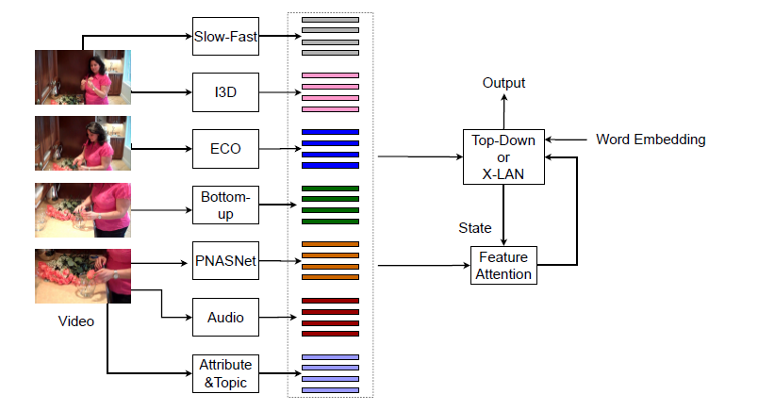
Methods – Architecture
Notes:
The whole architecture of our method is shown here. We extract multi-modal feature and use a feature attention module to attend on different features. For top-down model, the hidden state to compute attention is the hidden state of the first GRU. For X-LAN model, the hidden state to compute feature attention is the hidden state of the LSTM.
We use two types of decoders, top-down and X-LAN. We also ensemble the result of the top-down model and X-LAN model step by step.

Slide 8
Methods – Training details and tricks
Multi-stage training
Cross-entropy for 5 epochs, lr: 5e-4
Word-oracle to overcome exposure bias (ACL 2019), lr:5e-5
RL, self-critical (ICCV 2017), lr:5e-5
RL, self-critical (ICCV 2017), lr:5e-6
Other tricks
Beam search
Output dropout
https://arxiv.org/pdf/2006.03315.pdf
Notes:
We train the video captioning model with three stages. In the first stage, we use the traditional cross-entropy loss for 5 epochs. The learning rate is fixed at 5e-4. Then we leverage word-level oracle with learning rate of 5e-5. When the CIDEr score of the validation data is no longer growing for 2 epochs, we begin the third stage, self-critical policy gradient training. CIDEr and BLEU-4 are equally optimized. First, the learning rate is 5e-5. When the increase of CIDEr metric is saturated, we decreased the learning rate to 5e-6to train the model until convergence.
We also use some tricks as well. We use beam search to enlarge the searching space for decoding. We also use an output dropout approach by masking some words when computing the loss. This operation brings about 0.5 CIDEr increasing.

Slide 9
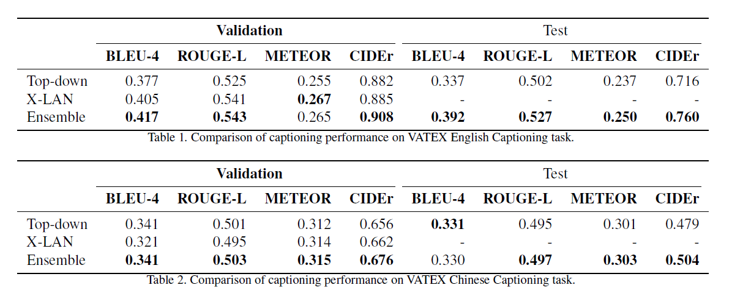
Results
Notes:
We show the quantitative result of the English and Chinese captioning tasks. For both English and Chinese captioning, X-LAN has better performance than top-down on validation set. The ensemble result achieves 0.76 CIDEr for English test set and 0.504 for Chinese test set. This result ranks 2nd on both English and Chinese captioning private test leaderboard.

Slide 10
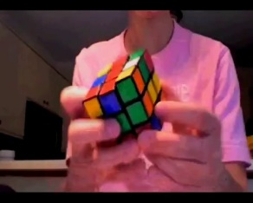
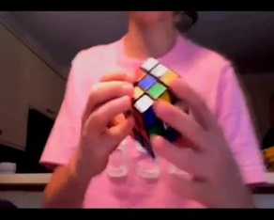
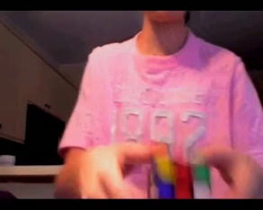
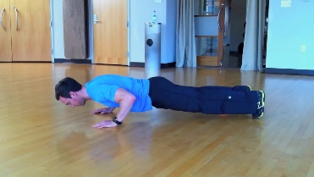
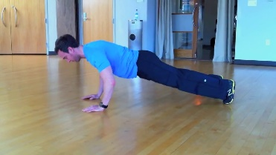
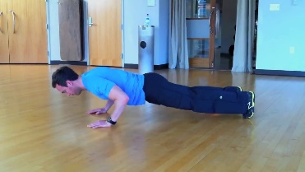
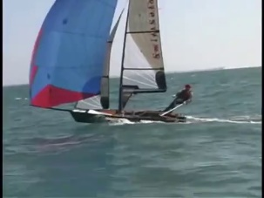
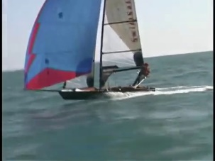
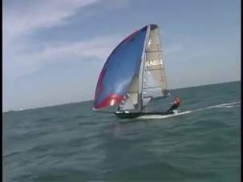
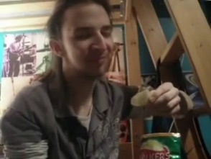
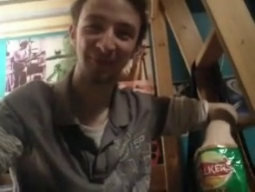
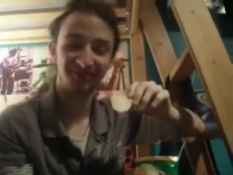
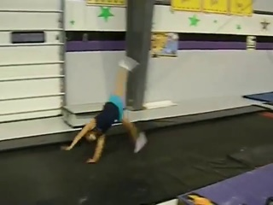
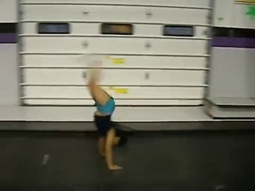
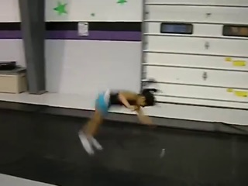



Results – Visualization
English
Chinese
a young man is demonstrating how to solve a rubik's cube and
一个 穿着 蓝色 衣服 的 男人 在 地板 上 做 俯卧撑
a person is sailing on a sail boat in the water and a
一个 穿着 灰色 衣服 的 男人 在 吃 着 薯片
a young girl is doing back flips on a mat in a gym
一个 穿着 黑色 衣服 的 小女孩 在 房间 里 说话
Notes:
Here we show the visualization result of the private test set using our method. Take the top-left one as example, the model generate a sentence which describe the activity which is solve a rubik’s cube of the man accurately. But it should be noticed that the end of the sentence looks illegal. The bad ending problem is a common problem why use self-critical training with the Cider metric as reward. This issue will be addressed in our future works.

Slide 11



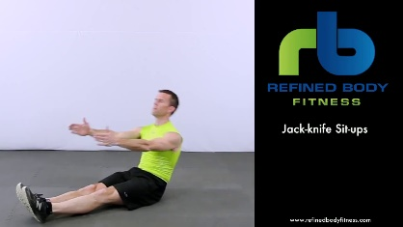
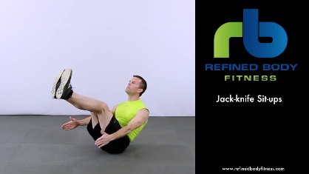
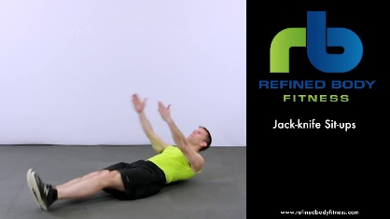
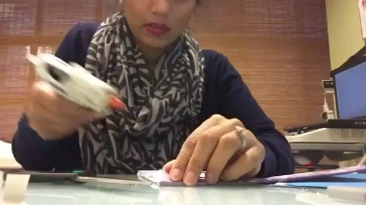
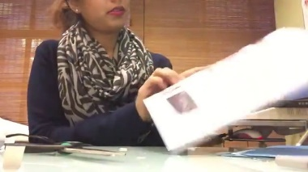
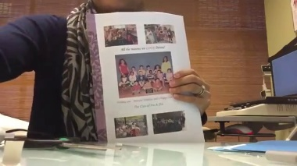
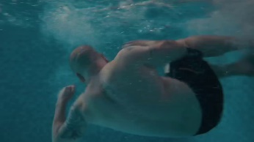

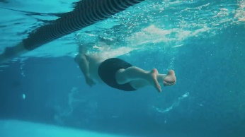
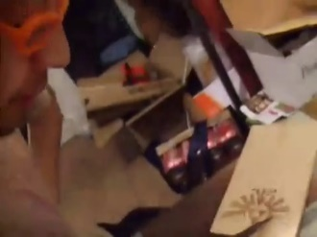
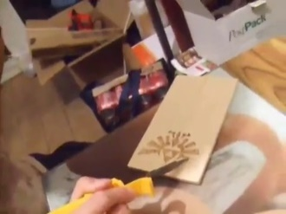
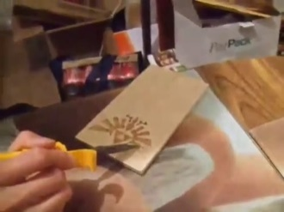

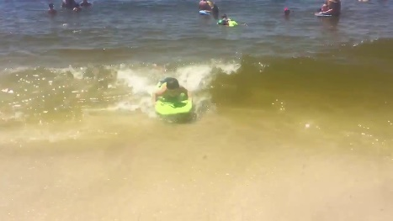
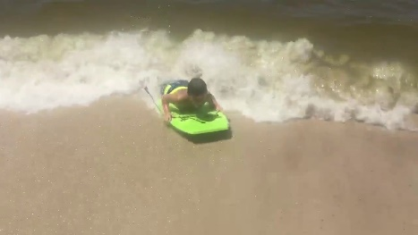
Results – Visualization failure cases
English
Chinese
a young girl is sitting in a car and eating a lollipop
一个 穿着 黑色 衣服 的 男人 躺 在 地板 上 做 仰卧起坐
a woman is sitting at a table and a newspaper and a man
一个 穿着 黑色 衣服 的 女人 在 游泳池 里 游泳
a man is opening a box and a man in a
一群 穿着 黑色 衣服 的 人 在 海里 游泳
Notes:
This slide show some failure cases. Either actions, objects or attributes are incorrectly decoded in these examples.

Slide 12
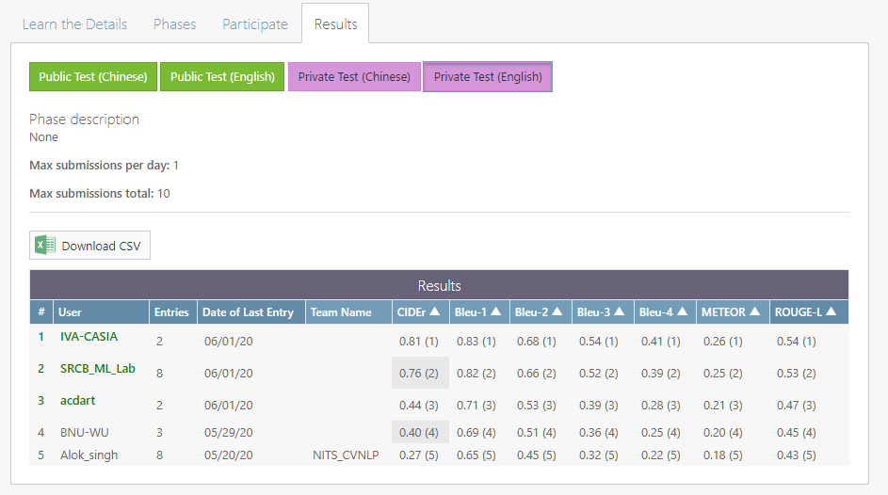
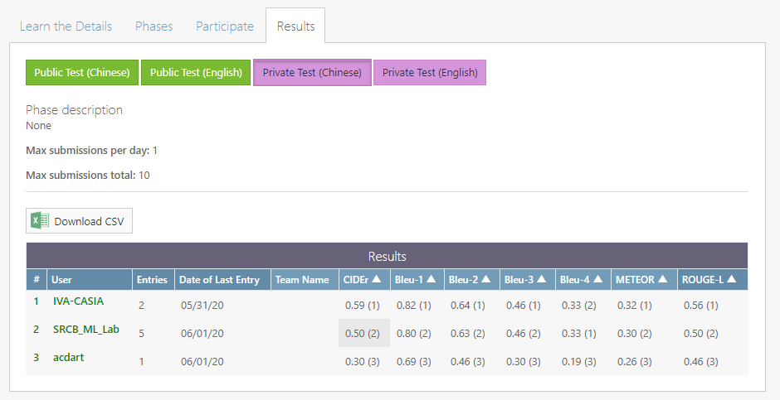
Results – Official Leaderboard
English
Chinese
https://competitions.codalab.org/competitions/24360#results
Notes:
The final leaderboard of English and Chinese captioning tasks are shown here. For both two tasks, we achieve the second place.

Slide 13
Thank you
Q &A
Notes:
Thank you for your time. Any questions are welcomed.

